Slide 1
Waste Classification using CNN
D. Venkat Prasad Varma - 2028093
Shubham Choudhary - 2028182
Ankit Lal - 2028188
Saikat Patra - 2028203

Slide 2
Aim of the Project
Main objective of this project is to classify the waste into four different categories using machine learning
1. Residual
2. Recyclable
3. Organic
4. Hazardous
Perform comparative analysis on multiple CNN models using transfer learning and select the best performing model.
To test and evaluate model performance on real world images
Develop a interactive web-page for predicting new images.

Slide 3
Introduction
Waste classification has become a major concern for societies across the globe, as the volume of waste generated continues to increase. Manual waste classification is not only time-consuming but also often inaccurate.
Machine learning offers a promising solution to this problem by enabling accurate and efficient waste classification. This technology uses algorithms and statistical models to analyze large datasets and identify patterns and trends. Once trained, machine learning models can classify waste with high accuracy, reducing the need for human intervention and improving overall waste management processes.
One of the key benefits of using machine learning for waste classification is its ability to learn from experience. As more waste is classified, the model becomes more accurate and efficient. This means that over time, the system will require less human input, reducing the likelihood of errors and improving overall efficiency.

Slide 4
Components used
Libraries:
bing_image_downloader: Allows bulk download of images from bing.com
tensorflow: Open source library for machine learning workloads
keras: Open source library providing pre-trained models. Uses tensorflow as backend
matplotlib: Cross-platform data visualization and graphical plotting library
Software:
Google Colab: Hosted jupyter notebook service providing access free access computing resources including GPUs.

Slide 5
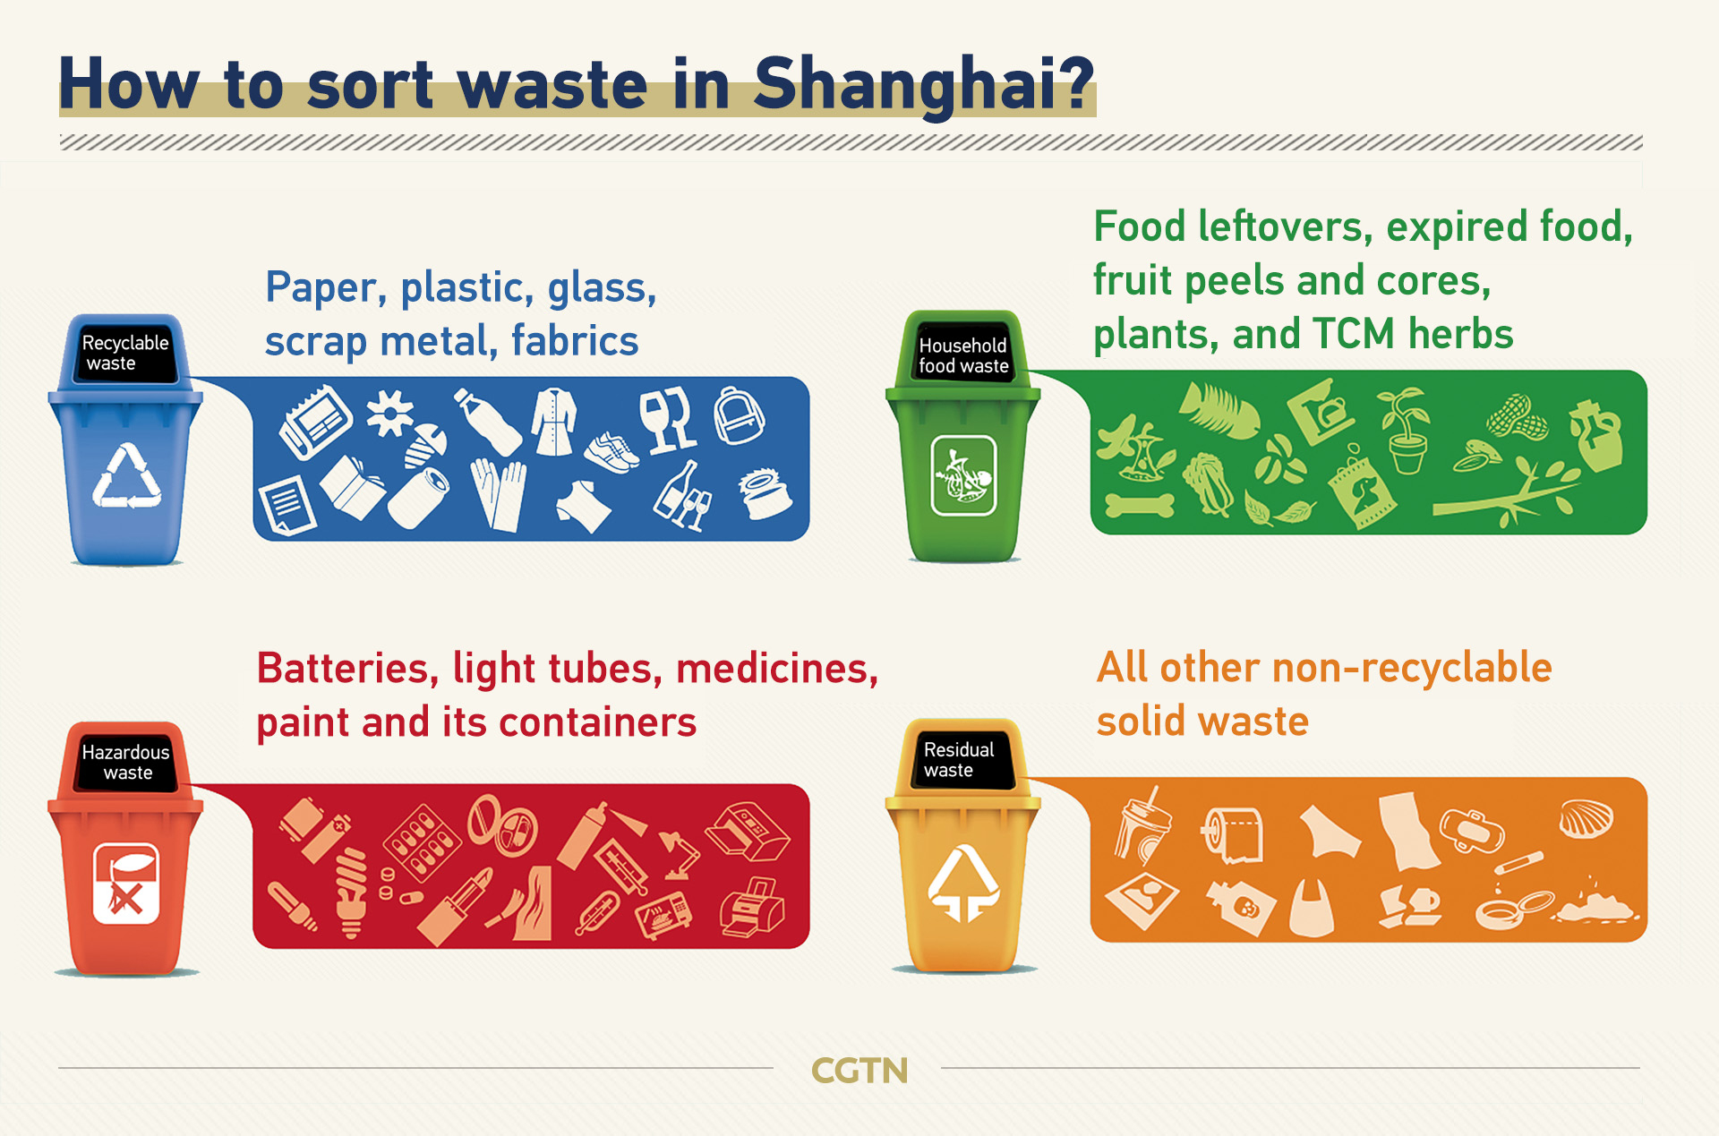
Dataset Description
Size: 9719 files belonging to 4 classes
Classes:
Hazardous:
Organic
Recyclable
Residual
Training/Validation/Testing Split: 80%/10%/10%

Slide 6
Literature Review
In 2018, Rahmi et.al [1] developed a Deep learning CNN model to classify the waste into three classes of Recyclable, Residual, and Non-Recyclable classes. The author used a TrashNet dataset containing 2527 images that belong to various classes. He used four Deep learning models Xception, MobileNet, Densely connected CNN, and Inception V4, in which his top accuracy models were Inception V4 with 89% accuracy, DenseNet and MobileNet with 84% accuracy. Adam and Adadelta were the optimizers he used in his study.
In 2016, Mindy et.al [2] have done a comparative analysis of SVM and CNN, where he concluded that SVM produces better results than CNN. They used SIFT algorithm for keypoint detection and 11-Levels in Neural Networks. SVM achieved a test accuracy of 66% while, CNN achieved a very low test accuracy of 22%. They classified the waste into three classes, Recyclable, Residual, and Non-Recyclable.

Slide 7
Literature Review
In 2019, Victoria et.al [3] developed an automated system that captures images of waste items and classifies them into different categories such as paper, plastic, metal, and glass. The system uses a combination of image preprocessing techniques, feature extraction, and a support vector machine (SVM) classifier to achieve high classification accuracy. The authors tested the system using a dataset of waste images and achieved an overall classification accuracy of 92.17%. The proposed method has potential applications in waste management and recycling industries to improve waste sorting efficiency.
In 2020, Dipesh et.al [4] performed a comparative analysis of multiple CNN models for waste classification. They found that InceptionV3 had the highest accuracy and F1 score, while VGG16 had the highest precision and recall. The authors also analyzed the confusion matrix of each model to identify common misclassifications. The results showed that deep CNN models are effective for waste classification and could be useful in developing automated waste sorting systems.

Slide 8
Literature Review
In 2016, J.Donovan et.al [5] developed an Auto-Trash which was able to differentiate between compost and was recycled with Raspberry Pi, their system was developed using Google’s Tensorflow. The short-come of their system was that it was only able to differentiate compost materials.
In 2022 Majchrowska et.al [6] proposed a deep learning framework using a two-stage detector to identify and classify garbage into seven categories with a level of accuracy up to 75%. The first stage manages litter localization without focusing on its class type with the help of EfficientDet-D2, and the second phase follows the classification of the identified waste into seven categories where the training of the classifier is undertaken by the un-labeled images in a semi-supervised manner. The scheme suggests a mobile application using Deep learning which can precisely identify the category of the waste item.
.

Slide 9
Literature Review
In 2019, Adedeji et.al [7] propose a waste classification system that employs deep learning convolutional neural network (CNN) to accurately classify waste into different categories. The system involves the collection of waste images, preprocessing and augmentation of the images, training of a CNN model, and classification of new waste images using the trained model.
The authors conducted experiments using a dataset of waste images consisting of six different waste categories, and the results showed that the proposed system achieved an accuracy of 96.78% .
In 2021, Sylwia, et al. [8] proposed a garbage classification application that uses deep learning techniques to classify waste materials into different categories. The proposed system involves the collection of waste images, preprocessing and feature extraction of the images, training of a deep neural network (DNN) model using the extracted features, and classification of new waste images into different categories using the trained DNN model.The authors suggest that the system can be further improved by using more advanced deep learning techniques and by increasing the size of the dataset used for training the DNN model.

Slide 10
MobileNetV3Small
MobileNetV3 is a family of lightweight neural network architectures designed for mobile and embedded systems.
This model is optimized for resource-constrained environment with focus on achieving high accuracy with a small model size and less computational power.
A thin neural network architecture called MobileNetV3Small is designed for low-latency and low-power applications.
Compared to earlier MobileNet designs, it performs picture classification tasks with excellent accuracy while using fewer parameters and processes.
In 2019, Google released MobileNetV3Small, an updated version of the previous MobileNetV1 and MobileNet2 models.

Slide 11
VGG16(Visual Geometry Group 16):
VGG16 (Visual Geometry Group 16) is a convolutional neural network (CNN) architecture that was developed by the Visual Geometry Group at the University of Oxford in 2014.
It is a deep learning model that has been widely used for image classification tasks, including object recognition and detection.
The VGG16 architecture consists of 16 layers of convolutional and pooling layers, followed by three fully connected layers at the end.
VGG16 has large number of parameters, which makes it computationally expensive to train, but also enables it to achieve high accuracy on image classification tasks.

Slide 12
ResNet50V2
ResNet50V2 is a pre-trained deep convolutional neural network architecture
It belongs to the ResNet family and is a variant of the original ResNet50 model developed by Microsoft in 2015
ResNet50V2 has 50 layers of convolutional, pooling, and fully connected layers
It has been trained on the ImageNet dataset, consisting of millions of labeled images belonging to thousands of categories
"V2" in the name refers to the second version of ResNet50, which incorporates several improvements over the original model, such as better weight initialization and improved batch normalization
ResNet50V2 has shown excellent performance in various computer vision tasks such as object detection, and segmentation
It is often used as a starting point for transfer learning in these tasks
Its pre-trained weights can be fine-tuned on new datasets with fewer labeled images, allowing for faster and more accurate training of deep neural networks for specific applications.

Slide 13
EfficientNetV2B0
EfficientNetV2 are a family of image classification models, which achieve better parameter efficiency and faster training speed than previous versions.
It uses neural architecture search (NAS) to jointly optimize model size and training speed, and are scaled up in a way for faster training and inference speed.
The V2 version also has nearly half the parameters of the original EfficientNet, while maintaining similar or higher accuracies than the other models on the ImageNet dataset.
EfficientNetV2 models train much faster than state-of-the-art models while being up to 6.8x smaller
B0 is the baseline model, which is scaled up to obtain the whole family of EfficientNets, consisting of B0 - B3, S, M, L and XL

Slide 14
InceptionV3
InceptionV3 is a pre-trained deep convolutional neural network architecture
It was developed by Google in 2015 as a variant of the original Inception model
InceptionV3 has 48 convolutional layers, followed by global average pooling and a softmax output layer
It has been trained on the ImageNet dataset, which consists of millions of labeled images belonging to thousands of categories
InceptionV3 uses a unique architecture that incorporates multiple parallel convolutional layers of different sizes to extract features from images at different scales
This enables the model to recognize objects and patterns in images with greater accuracy and efficiency
InceptionV3 has achieved state-of-the-art performance in various computer vision tasks such as image classification, object detection, and segmentation

Slide 15
Xception:
Xception is a deep neural network architecture for image classification that was introduced by Google in 2016.
It is an extension of the Inception architecture and is designed to improve the efficiency and accuracy of image classification models.
Xception is a powerful and efficient deep learning model for image classification tasks, achieving state-of-the-art performance on large-scale image datasets such as ImageNet.
It has been used in a variety of applications, including object recognition, object detection, and image segmentation.

Slide 16
Methodology
Data collection: Collect a dataset of images that you want to analyze using a CNN. This dataset should be large and diverse enough. Preprocess the data to standardize.
Model selection: Choose an appropriate CNN architecture. Experiment with different architectures, such as varying the number and type of layers used in the CNN, to find the best model for your dataset and task.
Training: Train the CNN on your dataset using a supervised learning approach. This involves dividing the data into training and validation sets and using the training data to adjust the parameters of the CNN to minimize the error between the predicted output and the actual output.

Slide 17
Methodology
Hyperparameter tuning: Adjust the hyperparameters of the CNN, such as the learning rate or regularization parameters, to further improve the performance of the model.
Evaluation: Evaluate the performance of the trained CNN on a test dataset that was not used during training or hyperparameter tuning. Use appropriate metrics to measure the performance, such as accuracy, precision, recall, or F1 score.
Optimization: Optimize the CNN model to improve its performance on the task. This may involve techniques such as data augmentation, regularization, or transfer learning.
Deployment: Deploy the optimized CNN model in a real-world application, such as image recognition or object detection, using appropriate tools and frameworks.

Slide 18
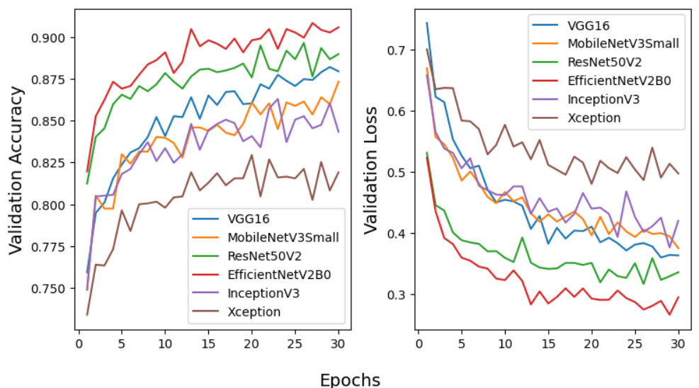
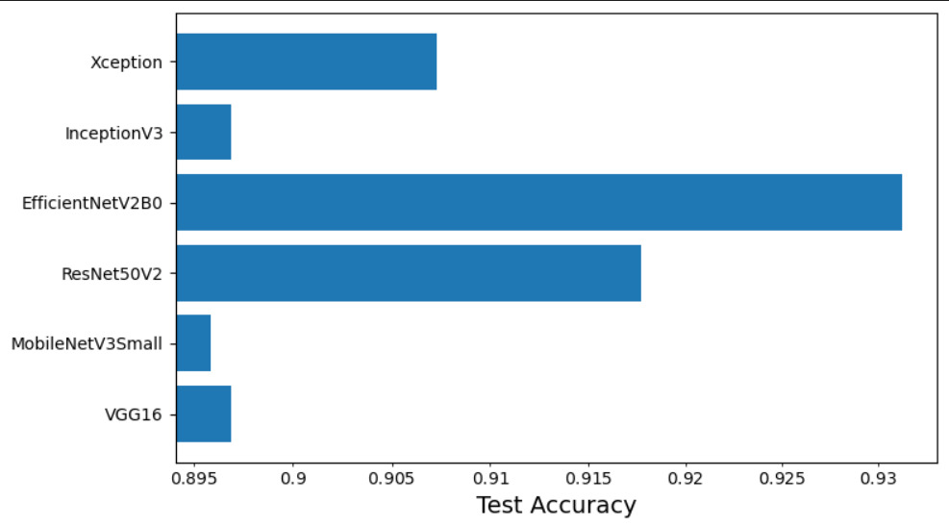
Test results
The result of CNN model for image classification are typically reported using various performance metrics, here we have shown testing accuracy and loss for all the models that we have used:

Slide 19
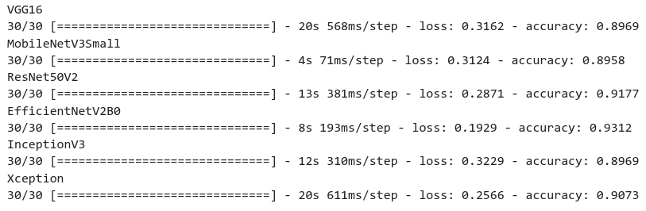
Test results

Slide 20
Conclusion
In this study, we have evaluated 6 pre-trained CNN models for the classification of waste. In our experiments, the best classification results were achieved using the EfficientNetV2 model with 93.12% test accuracy. Further improvement would likely be possible by:
Fine-tuning some of the layers of the original model with a smaller learning rate.
Adding more images to training dataset improve accuracy and prevent overfitting.

Slide 21
Future Scope
More images and new classes could be added in the dataset to obtain a model that predicts even more types of waste
The improved model could be implemented in real life with IoT and computer vision.
CV can identify and classify waste in real-time, and with the help of node-red we can toggle relays, which can segregate waste to their respective bins.
This can result in efficient and automated waste sorting without the need of human labor.

Slide 22
References
[1] Yang, M., & Thung, G. (2016). Classification of trash for recyclability status. CS229 project report, 2016(1), 3.
[2] Aral, R. A., Keskin, Ş. R., Kaya, M., & Hacıömeroğlu, M. (2018, December). Classification of trashnet dataset based on deep learning models. In 2018 IEEE International Conference on Big Data (Big Data) (pp. 2058-2062). IEEE.
[3] Ruiz, V., Sánchez, Á., Vélez, J. F., & Raducanu, B. (2019). Automatic image-based waste classification. In From Bioinspired Systems and Biomedical Applications to Machine Learning: 8th International Work-Conference on the Interplay Between Natural and Artificial Computation, IWINAC 2019, Almería, Spain, June 3–7, 2019, Proceedings, Part II 8 (pp. 422-431). Springer International Publishing.
[4] Gyawali, D., Regmi, A., Shakya, A., Gautam, A., & Shrestha, S. (2020). Comparative analysis of multiple deep CNN models for waste classification. arXiv preprint arXiv:2004.02168.
[5] J. Donovan, “No Title,” Auto-trash sorts garbage automatically at the techcrunch disrupt hackathon, 2016.
[6] Majchrowska, S.; Mikołajczyk, A.; Ferlin, M.; Klawikowska, Z.; Plantykow, M.A.; Kwasigroch, A.; Majek, K. Deep learning-based waste detection in natural and urban environments. Waste Manag. 2022, 138, 274–284. [Google Scholar] [CrossRef] [PubMed]
[7] Adedeji, O., & Wang, Z. (2019). Intelligent waste classification system using deep learning convolutional neural network. Procedia Manufacturing, 35, 607-612.
[8] Majchrowska, S., Mikołajczyk, A., Ferlin, M., Klawikowska, Z., Plantykow, M. A., Kwasigroch, A., & Majek, K. (2022). Deep learning-based waste detection in natural and urban environments. Waste Management, 138, 274-284.

Slide 23
Thank You

